Slide 1
Module 2 - Determine Your Organizational Readiness
Presented by: [Facilitator Name]
Date: [Session Date]
Notes:
Speaker Notes: Welcome to Module 2. In this module, we’ll explore the key concepts behind digital service delivery, what it means for government, and why it matters for acquisition professionals like you.

Slide 2
Module 2 Performance Outcome
Applying a discovery process sets the foundation for informed acquisition strategy decisions. By assessing organizational maturity, identifying key stakeholders, analyzing mission and user needs, evaluating risks, and performing market research, you will gather the data necessary to shape a successful digital service procurement.

Slide 3
At the conclusion of this module, you will be able to
Evaluate agency readiness and capacity for digital service procurement
Identify and engage key stakeholders, distinguishing them from users and customers
Define a digital service need and determine success criteria for the project and acquisition
Analyze constraints that may impact acquisition outcomes
Apply market research strategies to assess vendor capabilities for digital services
Notes:
Speaker Notes: These are our learning objectives for the module. As we go through each section, think about how these concepts connect to your own role and the challenges your agency faces.

Slide 4
Sprint 1
Assessing Agency Readiness

Slide 5
Maturity-Based Acquisition Strategy
Aligning Procurement with Organizational Readiness
Presented by: [Facilitator Name]
Date: [Session Date]
Notes:
Speaker Notes: Welcome everyone to today's session on Maturity-Based Acquisition Strategy. Our focus is on aligning procurement strategies with where your organization truly is in terms of readiness and capability. This session will be practical, discussion-driven, and tailored to the realities you face in digital service acquisition.

Slide 6
Agenda
Understand how organizational maturity impacts acquisition strategy risk
Recognize key risks unique to digital service procurements
Apply maturity-aligned acquisition strategy approaches to reduce procurement failure
Foster cross-functional team collaboration in strategy development
Notes:
Speaker Notes: These are our objectives for today. Think about them not just as theoretical takeaways, but as lenses for evaluating your current practices. Feel free to raise real challenges or experiences as we go along, so we can apply these concepts in a meaningful way.

Slide 7
On a scale of 1–5, how mature is your agency in digital service delivery?
What indicators informed your answer?
Notes:
Speaker Notes: Let’s start with a quick self-assessment. This is not about perfection or judgment—it’s about perspective. What do you see in your agency’s culture, processes, or results that influence your maturity rating? Capture your thoughts to revisit later.

Slide 8
Why Maturity Matters

Slide 9
Why Maturity Matters in Acquisition Strategy
Traditional acquisition assumes static requirements
Digital services are iterative and evolving
Maturity = readiness, not size
Key Factors:
Agile familiarity
Modular contract capacity
Governance alignment
Comfort with new models
Notes:
Speaker Notes: Many acquisition failures stem from a mismatch between organizational readiness and the demands of modern digital delivery. Maturity, in this context, is about how well-prepared your systems, people, and processes are to adapt and iterate.

Slide 10
Risk Axioms Overview

Slide 11
Four Foundational Risk Axioms for Digital Procurement
Procurement Time vs. Flexibility
Platform Ownership & Openness
Fixed Price & Delivery
Agile Adoption is a Long Game
Notes:
Speaker Notes: Here are four axioms that frame common risk patterns in digital procurement. Each axiom reflects a systemic tension between traditional practices and modern service realities. We'll explore each in more detail with examples and group reflection.

Slide 12
Axiom 1: Time vs. Flexibility
Long contracts reduce adaptability
Start with short, outcome-based contracts
Notes:
Speaker Notes: This axiom underscores the risk of being locked into inflexible arrangements. Long-term contracts make it hard to pivot when things go wrong. Instead, think of contracts as experiments with early checkpoints for adjustment.

Slide 13
Axiom 2: Platform Openness
Prefer open-source/COTS with government ownership
Design for interoperability and fast integration
Notes:
Speaker Notes: This is about retaining control. Open platforms reduce vendor lock-in, enabling better long-term value and agility. Think about how you design acquisitions to support openness and portability.

Slide 14
Axiom 3: Fixed Price
Use fixed-price by iteration/milestone
Requires clearly defined outcomes
Notes:
Speaker Notes: Fixed-price contracts can be helpful if scoped right. The key is to define deliverables around concrete outcomes, not vague aspirations. Otherwise, fixed-price becomes a risk amplifier instead of a control mechanism.

Slide 15
Axiom 4: Agile Maturity
Agile success builds over years
Use procurement to enable learning and iteration
Notes:
Speaker Notes: Agile isn’t just a methodology; it’s a cultural shift that takes time. Procurement can drive maturity by incrementally introducing agile practices and contracts that support experimentation and feedback.

Slide 16

Activity: Discussion
Activity: Match each axiom to a challenge your team has experienced.
Risk Axioms
Time vs Flexibility
Platform Openness
Fixed Price
Agile Maturity
Notes:
Speaker Notes: Let’s make this practical. Think back to a procurement that went off track. Which axiom does it relate to? What could have been done differently if that axiom had been addressed up front?

Slide 17
Whole-System Acquisition Strategy

Slide 18
Applying a Whole-System, Maturity-Aligned Approach
Avoid one-off, siloed procurements
Account for:
Budget cycles
Staffing realities
Change fatigue
Leadership readiness
Notes:
Speaker Notes: A successful strategy isn’t just technical—it must be organizational. Recognize that culture, leadership, and structural constraints can derail even the best-designed acquisitions. Think about your agency as a system, not just a buyer.

Slide 19
Cross-Functional Team Roles
Procurement Team: Structural design, vendor dynamics
Program Team: Mission fit, delivery tempo
Technical Team: Architecture, tool integration
Leadership/Legal: Culture, governance readiness
Notes:
Speaker Notes: Digital acquisition must be a team sport. Each of these groups brings essential knowledge. If any are left out, risk increases. Reflect on where your team is strong and where engagement could improve.

Slide 20
Modern Strategy Elements
View digital services as ongoing investments
Align funding and acquisition with delivery cycles
Build feedback loops into process
Notes:
Speaker Notes: Modern strategy is cyclical, not linear. Consider how to institutionalize feedback and build flexible structures that evolve with user needs. Digital services are never “done”—neither should your acquisition strategy be.

Slide 21
Maturity Assessment

Slide 22
Maturity Assessment Importance
Signals transparency and builds vendor trust
Aligns expectations and risk-sharing
Supports right-sized solutions
Notes:
Speaker Notes: Don’t hide your agency’s current maturity—use it as a foundation for honest vendor conversations. Right-sizing solutions leads to better proposals and fewer failed implementations. Transparency builds credibility.

Slide 23
Maturity Model Application
Use TechFAR or DSC Maturity Model
Assess internal and industry maturity
Notes:
Speaker Notes: Maturity models offer a shared language for evaluating readiness. Whether using TechFAR, DSC, or a custom tool, the key is to integrate the model early in the procurement lifecycle. Use it to shape goals and align your team.

Slide 24
Activity: Self-Assessment
Use maturity model handout
Rate your team’s current state
Discuss what approaches best fit your level
Notes:
Speaker Notes: Now it’s time to apply what we’ve learned. Use the model to assess your agency’s digital maturity. Then discuss what strategies make sense based on your actual state—not aspirational goals. Be honest; this is for planning, not scoring.

Slide 25
Optional Case Study: ADEPT (Maryland)
Multi-award agile procurement vehicle
Integrated maturity model into vendor selection
Notes:
Speaker Notes: Maryland’s ADEPT is a great example of maturity-based acquisition. They created an agile contract vehicle and screened vendors using maturity indicators. This shows what’s possible when you embed maturity awareness into strategy and operations.

Slide 26
Closing Discussion
What changes would you make to your next procurement strategy?
What support or resources would you need?
Notes:
Speaker Notes: Let’s reflect on what we’ve covered. If you had to revise a current or upcoming procurement strategy, what would you do differently based on today’s session? What barriers still exist—and how can you begin addressing them?

Slide 27
Key Takeaways
Maturity drives strategy success
Align risk, contracts, and delivery methods
Build cross-functional collaboration early
Notes:
Speaker Notes: To wrap up, remember: maturity matters. Align strategy to where your agency is—not where you hope to be. Use acquisition to build capability over time, and involve the right voices early.

Slide 28
Thank you
Contact information
Feedback survey link (if available)
Notes:
Speaker Notes: Thank you for your engagement today. Please reach out if you'd like templates, maturity models, or help facilitating these conversations with your team. Don’t forget to complete the feedback survey—we value your insights!

Slide 29
Why Readiness Matters

Slide 30
How Ready Is Your Agency for Change?
Before you can drive change, you need to understand your starting point.
Today’s activity helps you reflect on your agency’s mindset, behaviors, and conditions that support (or block) innovation.
Think of this as a mirror, not a test—your responses will help surface opportunities where you can make an impact.
Notes:
Speaker Notes: Say: “We’re kicking off this sprint by looking inward—at your agency and its readiness for digital transformation.”
Emphasize: “This is not about grading your agency—it’s about getting honest with yourself so you can lead more effectively.”
Encourage a growth mindset: “Wherever your agency is now, there are always levers you can pull or influence to move things forward.”
Transition: “You’ll complete a short survey that covers seven key areas—then we’ll come back together to share insights and start connecting dots.”

Slide 31

Activity: Change & Innovation Readiness Survey
Complete the survey individually.
Rate your agency on a scale of 1–5 across 7 statements.
Briefly explain why you gave each score.
Respond to the final reflection prompts.
Be ready to share any insights or patterns during our discussion.
Notes:
Speaker Notes: Say: “We’re kicking off this sprint by looking inward—at your agency and its readiness for digital transformation.”
Emphasize: “This is not about grading your agency—it’s about getting honest with yourself so you can lead more effectively.”
Encourage a growth mindset: “Wherever your agency is now, there are always levers you can pull or influence to move things forward.”
Transition: “You’ll complete a short survey that covers seven key areas—then we’ll come back together to share insights and start connecting dots.”

Slide 32
Sprint 2
Stakeholder and Customer Mapping

Slide 33
Understanding Your Needs & Mapping Stakeholders for Change
Presented by: [Facilitator Name]
Date: [Session Date]
Notes:
Speaker Notes:

Slide 34
Agenda
Define stakeholders, users, and customers
Explore techniques for stakeholder analysis and engagement
Notes:
Speaker Notes: These are our objectives for today.

Slide 35
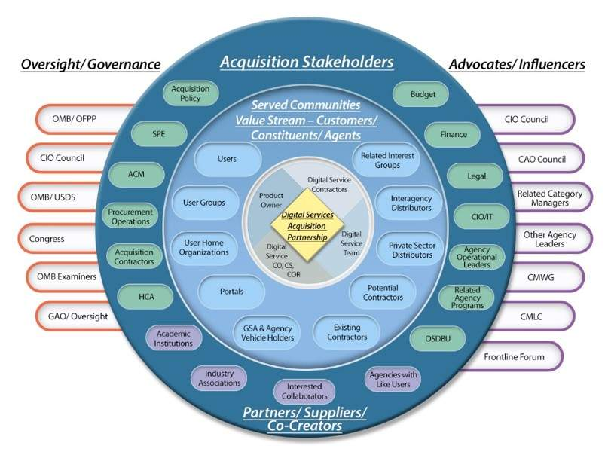
Seeing the Big Picture with Stakeholders
Notes:
Speaker Notes:
Educate learners that their view may be narrow ("soda straw") and should be expanded.
Discuss common “soda straw” views—why they limit transformation

Slide 36
Stakeholders vs. Users vs. Customers
Strategic (Exec leadership, CXOs)
Operational (Contracting, Tech Leads) - could be graphic
Regulatory (Privacy, Security, Legal)
End Users (Public, Internal staff)
Notes:
Speaker Notes:
Define and differentiate with examples
Consider stakeholders by their influence and interest, not just their job titles. Who are you leaving out by only looking at job titles?

Slide 37
Class Activity
Name that Stakeholder Type (Quiz)
Notes:
Speaker Notes:
Define and differentiate with examples
Consider stakeholders by their influence and interest, not just their job titles. Who are you leaving out by only looking at job titles?

Slide 38
Stakeholder Quiz
Deputy CIO who approves cloud services? (Answer: Strategic Stakeholder)
Notes:
Speaker Notes:
Define and differentiate with examples
Consider stakeholders by their influence and interest, not just their job titles. Who are you leaving out by only looking at job titles?

Slide 39
Stakeholder Quiz
Veteran Applying for Benefits Online (Answer: Customer)
Notes:
Speaker Notes:
Define and differentiate with examples
Consider stakeholders by their influence and interest, not just their job titles. Who are you leaving out by only looking at job titles?

Slide 40
Stakeholder Quiz
Benefits Call Center Representative (Answer: End User)
Notes:
Speaker Notes:
Define and differentiate with examples
Consider stakeholders by their influence and interest, not just their job titles. Who are you leaving out by only looking at job titles?

Slide 41
Common Stakeholder Mapping Mistakes
Mapping only based on title or org chart
Ignoring behind-the-scenes influencers (like admin officers or project analysts who have influence with leadership)
Forgetting contractors, policy advisors, or legal reviewers Underestimating interest shifts during different phases of a project
Notes:
Speaker Notes: This is an intro slide for the upcoming activity below.
Now let’s bring our stakeholder knowledge to life with a mapping activity. You’ll use a simple matrix to think critically about who really holds power and who cares most about your initiative.
Stakeholder Mapping & Power Dynamics (15 mins)
Help participants identify and categorize stakeholders based on influence (power) and interest (engagement level) in a digital service initiative.
Introduce the power-interest matrix
How might a high-influence, low-interest stakeholder impact your project?Interactive Activity:
Map sample stakeholders from a fictional or real agency scenario
Prompt: “Where would you place this person?”
Bonus: “How would their placement change over time?”

Slide 42
Optional Activity: Power Matrix
 | High Interest | Low Interest
High Influence (Key stakeholders, e.g. SES, program leaders) | Manage Closely | Keep Satisfied
Low Influence (less involved, low-impact) | Keep informed | Monitor (minimal effort)
Notes:
Speaker Notes: Now let’s bring our stakeholder knowledge to life with a mapping activity. You’ll use a simple matrix to think critically about who really holds power and who cares most about your initiative.
Stakeholder Mapping & Power Dynamics (15 mins)
Imagine your agency is planning a pilot program for a secure digital ID system. The pilot will affect customer experience, internal access, and procurement systems.
Share the case scenario (e.g., "Digital ID Pilot") Introduce 4–5 fictional characters
Use simple avatars or name badges with short bios (provided below)
Explain matrix axes:
Influence = ability to accelerate or block progress
Interest = how invested they are in the outcome
Characters: (read aloud)
Gloria, the SES IT Director – Approves funding, rarely attends meetings
Marcus, the Deputy CIO – Cybersecurity watchdog, hesitant about pilot risks
Leila, a Program Analyst – Works with the field teams; trusted voice
Alicia, the CX Lead Contractor – Influential but external to agency hierarchy
Ben, the Procurement Specialist – Likes consistency, risk-averse
Discussion Questions:
Where would you place each person on this matrix
Who’s high interest, high influence?
Who do you need to move?

Slide 43
What Drives Them: Stakeholder Psychology 101
Zone | Traits or Behaviors
🟥 Risk-Averse | Avoids uncertainty Focused on policy compliance Often senior leaders or legal advisors
🟨 Ambivalent | Open to new ideas, but needs proof Asks a lot of “what if” questions Watches others before acting Needs influence from others to tip them one way
🟩 Risk-Tolerant | Asks “What’s the upside?” Excited by new approaches Willing to test and iterate May be frustrated by red tape or slowness
Notes:
Speaker Notes:
** This is a visual or chart comparing engagement styles. Feel free to rebrand/updated this draft chart as needed.
Compare risk-averse vs. innovation-forward traits
Ask for hands or use polling (in Zoom or with sticky notes) to have participants mark the spectrum:
Put a dot where you think your stakeholder team lives today
Now put a second dot where you think they could be with the right support.
Where do your contracting office peers usually fall on this spectrum? Why?
Have you seen them move over time—or under different leadership?”
Interest = how invested they are in the outcome

Slide 44
What’s Your Plan When You Hear No?
Objection | Underlying Fear | Influence Strategy
“That’s not compliant” | Fear of doing something wrong | Ask for FAR citation, offer legal POV
“It’s too risky” | Fear of failure or blame | Offer pilot, show proof of concept
“We’ve never done it that way’ | Fear of change, loss of control | Share agency examples, start small
“Leadership won’t go for it” | Fear of wasting time | Ask: What would make it feel worth it?
“We don’t have time” | Overwhelm, prioritization challenges | Show how this saves time
Notes:
Speaker Notes:
** This is a visual or chart for navigating no. Rebrand/updated this draft chart as needed.
Building Buy-In & Navigating ‘No’ (10 mins)
Think of a recent time someone pushed back on a new approach or idea. What did they actually say—and what do you think was really behind it?
It's a process — sometimes it takes multiple meetings to shift a “no” to a “yes.”
Walk through one or two examples using this chart. Let people see that most objections are driven by fear—not logic—and that they can respond with empathy + a strategy.
Introduce objection-handling tools: Five Whys, influence strategies
Activity (Categorization Exercise): “Sort” stakeholders into: A) No forever B) Maybe with more info and C) Already onboard
Interest = how invested they are in the outcome

Slide 45

Case Study Activity:
Mapping Casey’s Stakeholders
Map out the key stakeholders in the case, using Milestone 1.
Notes:
Speaker Notes:
Many government teams—and their partners—contribute to advancing digital delivery. These groups create resources, prototypes, and momentum for modern practices.

Slide 46

Optional Role Play Activity: Stakeholder Influence
Roles Overview:
Role A: Digital service or acquisition professional with a specific goal/request.
Role B: A key stakeholder with decision-making authority who may resist the request (e.g., OGC Attorney, Procurement Executive, IT Governance Lead). Ideally played by a facilitator or guest actor.
Role C: Observers and debrief leaders who evaluate the scenario and provide feedback on the influencing strategies used.
Notes:
Speaker Notes: This is an optional activity that supports digital service acquisition professionals in practicing how to influence key stakeholders in legal, governance, and leadership roles. Scenarios reflect real-world, bureaucratic challenges that arise when advocating for non-traditional, user-centered procurement strategies. The emphasis is on developing strategies to navigate resistance and promote iterative, mission-aligned solutions.

Slide 47
Optional Role Play Activity: Structure Per Scenario
5 minutes – Debrief:
Role C leads the reflection using a set of structured prompts.
5 minutes – Transition:
Return to main room.
Share key takeaways.
Rotate participants and assign the next scenario.
5 minutes – Prep:
Role A prepares their strategy.
Role B reviews their stakeholder stance.
Role C reviews the scenario and prepares to lead the debrief.
5 minutes – Role Play:
Roles A and B engage in the conversation.
Facilitator may lightly guide if needed.
Notes:
Speaker Notes: This is an optional activity that supports digital service acquisition professionals in practicing how to influence key stakeholders in legal, governance, and leadership roles. Scenarios reflect real-world, bureaucratic challenges that arise when advocating for non-traditional, user-centered procurement strategies. The emphasis is on developing strategies to navigate resistance and promote iterative, mission-aligned solutions.

Slide 48
Stakeholder Interview Assignment

Slide 49
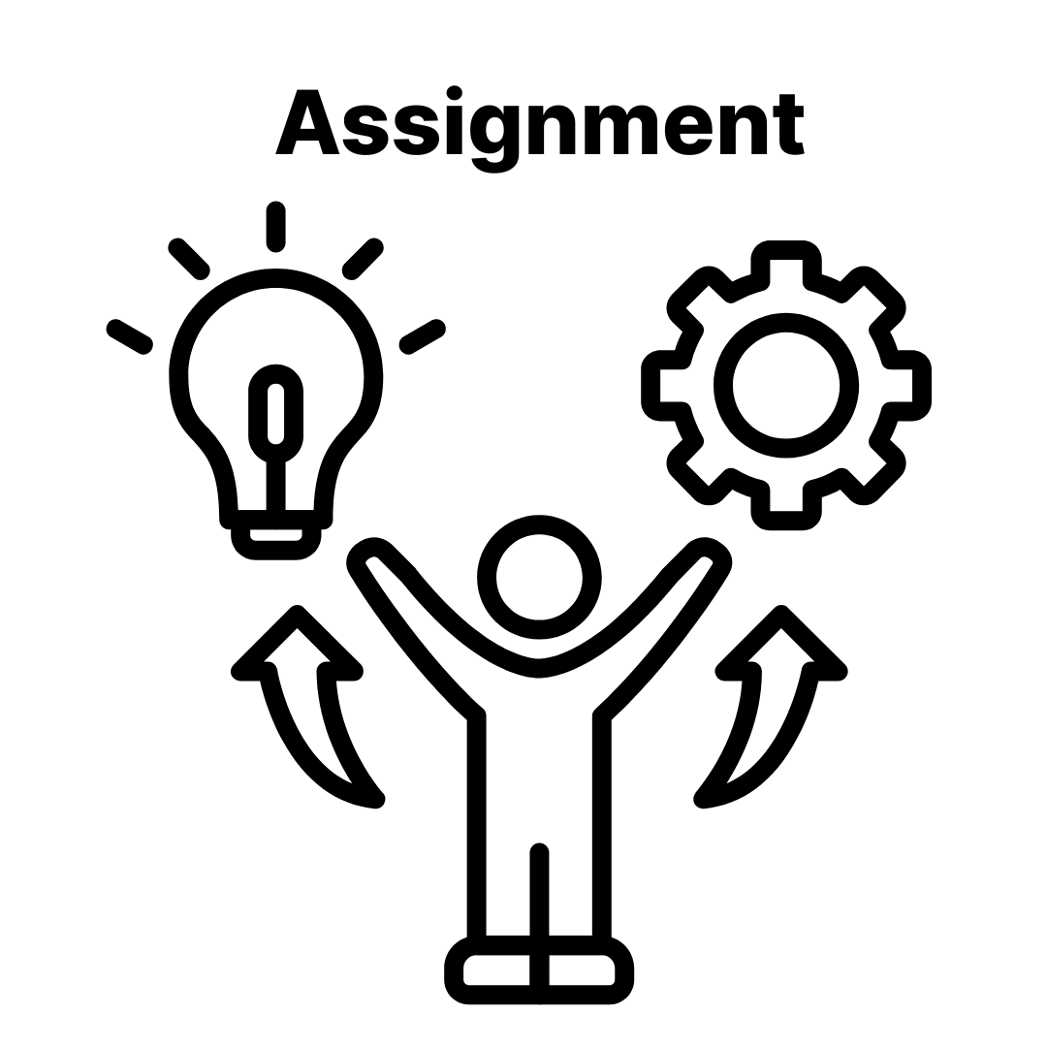
Part 1: Prepare
Identify 2–4 key stakeholders or gatekeepers
Research their role, responsibilities, and relationships
Develop your influence strategy and questions
(Optional) Practice with a peer
Submit your prep by end of Module 2
Assignment Prep: Stakeholder Selection
Notes:
Speaker Notes: This assignment will allow you to build your skills in stakeholder engagement, influence, and agency change readiness by identifying and interviewing real decision-makers at your agency.

Slide 50
Assignment Prep: Stakeholder Selection
Part 2: Engage
Conduct 2–4 interviews
Test your assumptions and influence strategies
Reflect on what you learned
Submit a short write-up + insights
Notes:
Speaker Notes: This assignment will allow you to build your skills in stakeholder engagement, influence, and agency change readiness by identifying and interviewing real decision-makers at your agency.

Slide 51
Sprint 3
Defining Success for Your Digital Services Acquisition

Slide 52
Defining Success
Presented by: [Facilitator Name]
Date: [Session Date]
Notes:
Speaker Notes:

Slide 53
Agenda
Setting a Clear Product Vision: Aligning User Stories and Objectives
Visioning Exercises: Defining the Problem and the Product
Defining Success: Desired Outcomes and Acquisition Goals
Talking Metrics: Framing Success Beyond Budget and Timeline
What Are You Really Buying? People, Process, or Product
Navigating Constraints: Identifying Barriers to Success
Notes:
Speaker Notes: These are our objectives for today.

Slide 54
Activity: Using AI to translate Vision into Return on Mission
Instructions
Split into small groups
Start with a Product Vision
Prompt the AI
Review and Refine
Capture the Output
Notes:
Speaker Notes: Keyframing Before You Begin (2–3 min):
“In the private sector, ROI means profit. But in government, the true ‘return’ is mission impact. Today we’ll practice using AI to translate a product vision into something more meaningful—a Return on Mission and metrics that help us measure real outcomes.”
Emphasize:
RoM is not fluff—it’s what helps justify strategy decisions to reviewers and stakeholders. We want to move beyond compliance metrics and into public value and mission impact.
During the Activity (10 min):
Use these to guide discussion after the activity:
What stood out to you about how the AI described the mission impact?
Did the metrics it generated feel relevant and actionable for a procurement?
How might you improve the prompt to get better results?
How can you use this type of exercise to accelerate collaboration with CORs or Program teams?
Closing Remark:
“When we center acquisition strategies around Return on Mission, we not only build better contracts—we build better outcomes for the people we serve.”

Slide 55
Introducing the Acq-A-Thon
What is it?
What happens in an Acq-A-thon:
Define the problem and mission goals
Clarify the product vision
Identify key constraints (tech, legal, budget)
Draft an early acquisition approach
A collaborative planning planning workshop that brings key stakeholders together to design smarter, more mission-aligned acquisition strategies
Notes:
Speaker Notes:
The Acq-A-thon is a collaborative, hands-on approach to acquisition planning designed to get everyone aligned early. Too often, acquisition planning happens in silos—program offices do their part, contracting does theirs, and only later do gaps, risks, or misunderstandings surface. The Acq-A-thon flips that model.
It’s inspired by hackathons in the tech world—fast-paced, problem-solving sessions—but instead of writing code, stakeholders come together to clarify needs, explore constraints, and co-create smarter strategies.
While we won’t be running an Acq-A-thon in this course, we want you to know this is a tool you can use back in your agency. I’ll walk you through:
The purpose and goals of an Acq-A-thon
What typically happens during one
Who should be involved
The kinds of outcomes you can expect
As you listen, think about how you might adapt this model—formally or in a lightweight version—for your own projects. This is about giving you another tool in your acquisition toolbox to help you plan more effectively and collaboratively.

Slide 56
Acq-A-Thon: Who Should be in the Room?
Must-Haves
Program Office/Requirements Owner
Contracting Officer
Contracting Officer’s Representative (COR)
Product Owner (or person responsible for day-to-day delivery decisions
Should-Haves:
Define the problem and mission goals
Clarify the product vision
Identify key constraints (tech, legal, budget)
Draft an early acquisition approach
Notes:
Speaker Notes:
The Acq-A-thon is a collaborative, hands-on approach to acquisition planning designed to get everyone aligned early. Too often, acquisition planning happens in silos—program offices do their part, contracting does theirs, and only later do gaps, risks, or misunderstandings surface. The Acq-A-thon flips that model.
It’s inspired by hackathons in the tech world—fast-paced, problem-solving sessions—but instead of writing code, stakeholders come together to clarify needs, explore constraints, and co-create smarter strategies.
While we won’t be running an Acq-A-thon in this course, we want you to know this is a tool you can use back in your agency. I’ll walk you through:
The purpose and goals of an Acq-A-thon
What typically happens during one
Who should be involved
The kinds of outcomes you can expect
As you listen, think about how you might adapt this model—formally or in a lightweight version—for your own projects. This is about giving you another tool in your acquisition toolbox to help you plan more effectively and collaboratively.

Slide 57
Acq-A-Thon: Outcomes of this Activity
By the end of this event, you should have:
A clear and collaboratively developed Problem Statement
Defined Success Criteria (Return on Mission)
A high-level Product Vision
Identified Constraints (technical, budgetary, legal, operational)
A draft Acquisition Hypothesis that outlines the initial path for market research and strategy development
Notes:
Speaker Notes:
The Acq-A-thon is a collaborative, hands-on approach to acquisition planning designed to get everyone aligned early. Too often, acquisition planning happens in silos—program offices do their part, contracting does theirs, and only later do gaps, risks, or misunderstandings surface. The Acq-A-thon flips that model.
It’s inspired by hackathons in the tech world—fast-paced, problem-solving sessions—but instead of writing code, stakeholders come together to clarify needs, explore constraints, and co-create smarter strategies.
While we won’t be running an Acq-A-thon in this course, we want you to know this is a tool you can use back in your agency. I’ll walk you through:
The purpose and goals of an Acq-A-thon
What typically happens during one
Who should be involved
The kinds of outcomes you can expect
As you listen, think about how you might adapt this model—formally or in a lightweight version—for your own projects. This is about giving you another tool in your acquisition toolbox to help you plan more effectively and collaboratively.

Slide 58
Sprint 4
Conducting Effective Market Research

Slide 59
Agenda
Drafting a clear needs statement to anchor market research
Exploring market segments and assessing vendor capabilities
Selecting the right market research methods for digital services
Minimizing industry burden while maximizing insight
Applying strategies to match needs with the right market
Notes:
Speaker Notes: These are our objectives for today.

Slide 60
Case Study Activity:
Market Research Planning
Identify 2–3 key open questions or uncertainties
List information sources (e.g., user interviews, IT inventories, RFIs)
Choose methods to fill gaps (e.g., industry scan, stakeholder interviews)
Notes:
Speaker Notes:
Many government teams—and their partners—contribute to advancing digital delivery. These groups create resources, prototypes, and momentum for modern practices.

Slide 61
Questions?

Slide 62
Thank you
Contact information
Feedback survey link (if available)

